Slide 1
Never Been KIST: Tor’s Congestion Management Blossoms with Kernel-Informed Socket Transport
23rd USENIX Security Symposium
August 20th 2014
Rob Jansen US Naval Research Laboratory
John Geddes University of Minnesota
Chris Wacek Georgetown University
Micah Sherr Georgetown University
Paul Syverson US Naval Research Laboratory

Slide 2
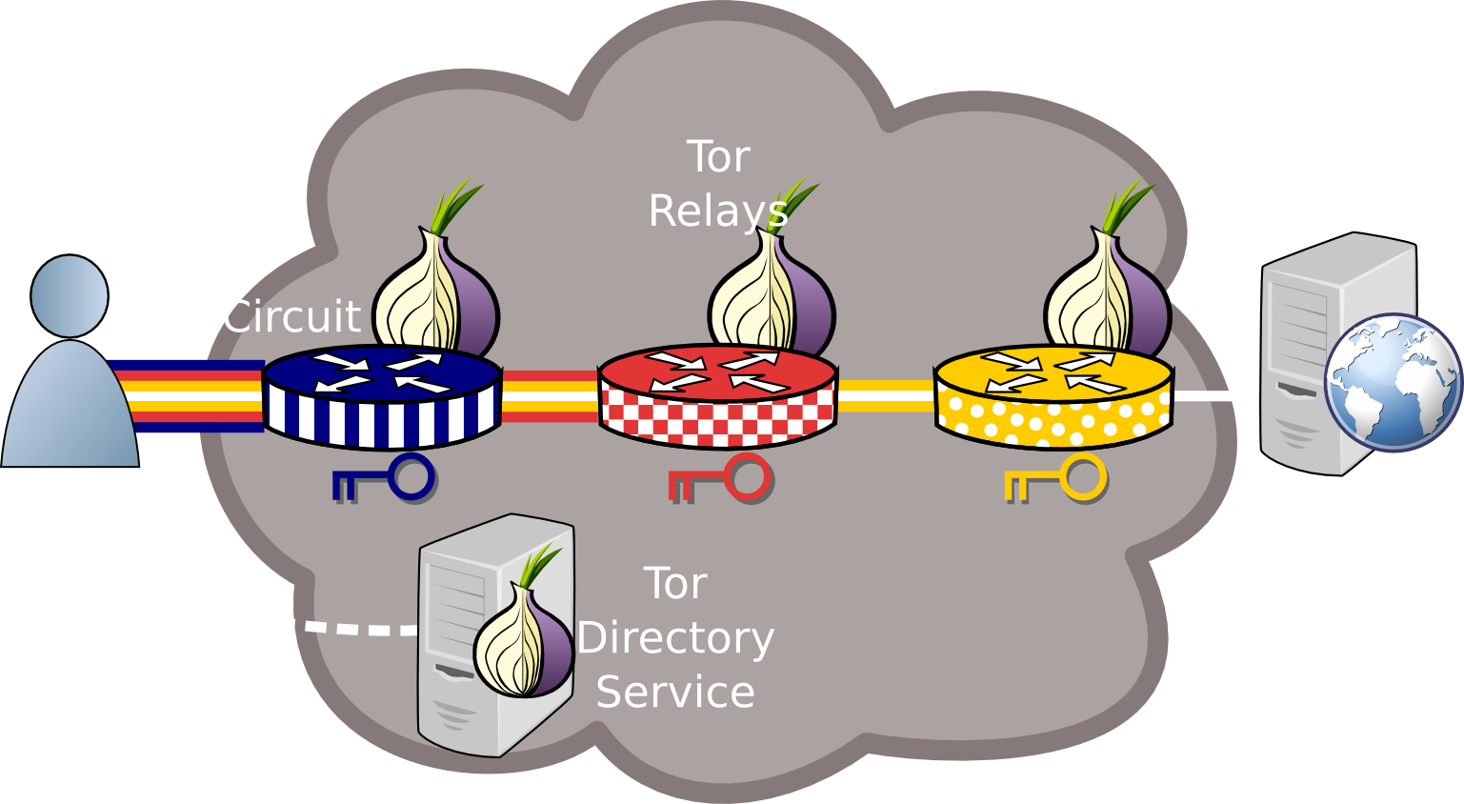
Anonymous Communication: Tor

Slide 3
Tor is Slow!!! Research*
PCTCP: Per-Circuit TCP-over-IPsec Transport for Anonymous Communication Overlay Networks (CCS ‘13)
Reducing Latency in Tor Circuits with Unordered Delivery (FOCI ‘13)
How Low Can You Go: Balancing Performance with Anonymity in Tor (PETS ‘13)
The Path Less Travelled: Overcoming Tor's Bottlenecks with Traffic Splitting (PETS ’13)
An Empirical Evaluation of Relay Selection in Tor (NDSS ‘13)
LIRA: Lightweight Incentivized Routing for Anonymity (NDSS ‘13)
Improving Performance and Anonymity in the Tor Network (IPCCC ‘12)
Enhancing Tor's Performance using Real-time Traffic Classification (CCS ’12)
Torchestra: Reducing interactive traffic delays over Tor (WPES ‘12)
Throttling Tor Bandwidth Parasites (USENIX Sec ‘12)
LASTor: A Low-Latency AS-Aware Tor Client (Oakland ‘12)
Congestion-aware Path Selection for Tor (FC ‘12)
*Not a comprehensive list

Slide 4
Tor is Slow!!! Research*
PCTCP: Per-Circuit TCP-over-IPsec Transport for Anonymous Communication Overlay Networks (CCS ‘13)
Reducing Latency in Tor Circuits with Unordered Delivery (FOCI ‘13)
How Low Can You Go: Balancing Performance with Anonymity in Tor (PETS ‘13)
The Path Less Travelled: Overcoming Tor's Bottlenecks with Traffic Splitting (PETS ’13)
An Empirical Evaluation of Relay Selection in Tor (NDSS ‘13)
LIRA: Lightweight Incentivized Routing for Anonymity (NDSS ‘13)
Improving Performance and Anonymity in the Tor Network (IPCCC ‘12)
Enhancing Tor's Performance using Real-time Traffic Classification (CCS ’12)
Torchestra: Reducing interactive traffic delays over Tor (WPES ‘12)
Throttling Tor Bandwidth Parasites (USENIX Sec ‘12)
LASTor: A Low-Latency AS-Aware Tor Client (Oakland ‘12)
Congestion-aware Path Selection for Tor (FC ‘12)
Where?
*Not a comprehensive list

Slide 5
This Talk
Where is Tor slow?
Measure public Tor and private Shadow-Tor networks
Identify circuit scheduling and socket flushing problems
Design KIST: Kernel-Informed Socket Transport
Use TCP snd_cwnd to limit socket writes
Evaluate KIST Performance and Security
Reduces kernel and end-to-end circuit congestion
Throughput attacks unaffected, speeds up latency attacks

Slide 6
Outline
Background
Instrument Tor, measure congestion
Analyze causes of congestion
Design and evaluate KIST
Performance
Security

Slide 7

Relay Overview

Slide 8




Relay Overview
TCP
TCP
TCP
TCP
TCP
TCP
TCP
Tor circuits are multiplexed over a TCP transport

Slide 9

Relay Overview
TCP
TCP
TCP
TCP
TCP
TCP
TCP

Slide 10
Relay Internals
Kernel Input
Tor Input
Tor Output
Kernel Output
Tor Circuits
Opportunities for traffic management

Slide 11
Outline
Background
Instrument Tor, measure congestion
Analyze causes of congestion
Design and evaluate KIST
Performance
Security

Slide 12
Live Tor Congestion - libkqtime
Kernel Input
Tor Input
Tor Output
Kernel Output
Tor Circuits

Slide 13
Live Tor Congestion - libkqtime
Kernel Input
Tor Input
Tor Output
Kernel Output
Tor Circuits
tag
match
tag
match

Slide 14
Live Tor Congestion - libkqtime
Kernel Input
Tor Input
Tor Output
Kernel Output
Tor Circuits
tag
match
tag
match
track cells

Slide 15
Shadow Network Simulation
Enhanced Shadow with several missing TCP algorithms
CUBIC congestion control
Retransmission timers
Selective acknowledgements (SACK)
Forward acknowledgements (FACK)
Fast retransmit/recovery
Designed largest known private Tor network
3600 relays and 12000 simultaneously active clients
Internet topology graph: ~700k nodes and 1.3m links

Slide 16
Shadow-Tor Congestion – UIDs
Track the UID
UID
Track the UID
UID

Slide 17
Shadow-Tor Congestion – UIDs
Track the UID
UID
Track the UID
UID
Kernel Input
Tor Input
Tor Circuits
Tor Output
Kernel Output

Slide 18
Tor and Shadow-Tor Congestion
Live-Tor
Shadow-Tor
Congestion occurs almost exclusively in outbound kernel buffers

Slide 19
Outline
Background
Instrument Tor, measure congestion
Analyze causes of congestion
Design and evaluate KIST
Performance
Security

Slide 20
Analyzing Causes of Congestion
Tor Output
Kernel Output
Tor Circuits
Queuing delays in kernel output buffer

Slide 21
Analyzing Causes of Congestion
Tor Output
Kernel Output
Tor Circuits
Problem 1:
Circuit scheduling
Problem 2:
Flushing to Sockets
Queuing delays in kernel output buffer

Slide 22
Problem 1: Circuit Scheduling
Tor Output
Kernel Output
Tor Circuits
Libevent schedules one connection at a time

Slide 23
Problem 1: Circuit Scheduling
Tor Output
Kernel Output
Tor Circuits
Tor only considers a subset of writable circuits
Libevent schedules one connection at a time

Slide 24
Problem 1: Circuit Scheduling
Tor Output
Kernel Output
Tor Circuits
Tor only considers a subset of writable circuits
Circuits from different connections are not prioritized correctly
Libevent schedules one connection at a time

Slide 25
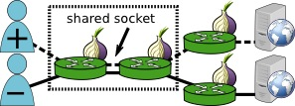
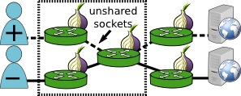
Problem 1: Circuit Scheduling

Slide 26
Problem 1: Circuit Scheduling
Correctly differentiated
No differentiation

Slide 27
Problem 1: Circuit Scheduling
Correctly differentiated
No differentiation
99.775% of any two circuits are unshared

Slide 28
Problem 2: Flushing to Sockets
Tor Output
Kernel Output
Tor Circuits
FIFO
Queuing delays in kernel output buffer

Slide 29
Problem 2: Flushing to Sockets
Tor Output
Kernel Output
Tor Circuits
Worse priority traffic (high throughput flows)
FIFO

Slide 30
Problem 2: Flushing to Sockets
Tor Output
Kernel Output
Tor Circuits
Worse priority traffic (high throughput flows)
FIFO
Better priority traffic
(low throughput flows)

Slide 31
Problem 2: Flushing to Sockets
Tor Output
Kernel Output
Tor Circuits
Worse priority traffic (high throughput flows)
FIFO
Must wait for kernel to flush socket to network (blocked on TCP cwnd)
Better priority traffic
(low throughput flows)

Slide 32
Problem 2: Flushing to Sockets
Tor Output
Kernel Output
Tor Circuits
Worse priority traffic (high throughput flows)
FIFO
Better priority traffic
(low throughput flows)
Reduces effectiveness of circuit priority

Slide 33
Outline
Background
Instrument Tor, measure congestion
Analyze causes of congestion
Design and evaluate KIST
Performance
Security

Slide 34
Ask the kernel, stupid!
Utilize getsockopt and ioctl syscalls
socket_space =
sndbufcap – sndbuflen
tcp_space =
(cwnd – unacked) * mss
sndbufcap
cwnd
sndbuflen
unacked

Slide 35
Kernel-Informed Socket Transport
Don’t write it if the kernel can’t send it; bound kernel writes by:
Socket: min(socket_space, tcp_space)
Global: upstream bandwidth capacity
Solution to Problem 2

Slide 36
Kernel-Informed Socket Transport
Don’t write it if the kernel can’t send it; bound kernel writes by:
Socket: min(socket_space, tcp_space)
Global: upstream bandwidth capacity
Choose globally from all writable circuits
Solution to Problem 1

Slide 37
Kernel-Informed Socket Transport
Don’t write it if the kernel can’t send it; bound kernel writes by:
Socket: min(socket_space, tcp_space)
Global: upstream bandwidth capacity
Choose globally from all writable circuits
Try to write again before kernel starvation

Slide 38
KIST Reduces Kernel Congestion

Slide 39
KIST Increases Tor Congestion

Slide 40
KIST Reduces Circuit Congestion

Slide 41
KIST Improves Network Latency

Slide 42
Outline
Background
Instrument Tor, measure congestion
Analyze causes of congestion
Design and evaluate KIST
Performance
Security

Slide 43


Traffic Correlation: Latency
Goal: narrow down potential locations of the client on a target circuit
Hopper et.al. CCS’07

Slide 44
Traffic Correlation: Latency
-Inject redirect or javascript
-Start timer
Hopper et.al. CCS’07

Slide 45
Traffic Correlation: Latency
GET
Request redirected page or embedded object
Hopper et.al. CCS’07

Slide 46
Traffic Correlation: Latency
GET
-Stop timer
-Estimate latency
Hopper et.al. CCS’07

Slide 47
Latency Attack | estimate – actual |

Slide 48
Latency Attack num pings until best estimate

Slide 49
Traffic Correlation: Throughput
Goal: find guard relay of the client on a target circuit
Mittal et.al. CCS’11

Slide 50


Traffic Correlation: Throughput
Probe throughput of all guard relays
Mittal et.al. CCS’11

Slide 51

Traffic Correlation: Throughput
Correlate throughput between exit and probes
Mittal et.al. CCS’11

Slide 52
Throughput Attack Results

Slide 53
Conclusion
Where is Tor slow?
KIST complements other performance enhancements, e.g. circuit priority
Next steps
Currently exploring various algorithmic optimizations
Test KIST in the wild and deploy in Tor

Slide 54

Questions?
rob.g.jansen@nrl.navy.mil
robgjansen.com
github.com/robgjansen/libkqtime
github.com/shadow
think like an adversary

Slide 55
Relay Internals
Kernel Input
Tor Input
Tor Output
Kernel Output
Tor Circuits
Network Input

Slide 56
Relay Internals
Kernel Input
Tor Input
Tor Output
Kernel Output
Tor Circuits
Split data into socket buffers

Slide 57
Relay Internals
Kernel Input
Tor Input
Tor Output
Kernel Output
Tor Circuits
Read data from sockets into Tor

Slide 58
Relay Internals
Kernel Input
Tor Input
Tor Output
Kernel Output
Tor Circuits
Process data (encrypt/decrypt)

Slide 59
Relay Internals
Kernel Input
Tor Input
Tor Output
Kernel Output
Tor Circuits
Split cells into circuit queues

Slide 60
Relay Internals
Kernel Input
Tor Input
Tor Output
Kernel Output
Tor Circuits
Circuits linked to outgoing connection

Slide 61
Relay Internals
Kernel Input
Tor Input
Tor Output
Kernel Output
Tor Circuits
Schedule cells

Slide 62
Relay Internals
Kernel Input
Tor Input
Tor Output
Kernel Output
Tor Circuits
Write data from Tor into sockets

Slide 63
Relay Internals
Kernel Input
Tor Input
Tor Output
Kernel Output
Tor Circuits
Schedule data for sending

Slide 64
Relay Internals
Kernel Input
Tor Input
Tor Output
Kernel Output
Tor Circuits
Opportunities for traffic management

Slide 65
KIST Improves Network Throughput

